Slide 1


ITF ‘Security Matters’ Forum
Are we missing a trick in managing our risks? People, behaviours and the boardroom
Nick Wilding, General Manager, Cyber Resilience, AXELOS
23 March 2018

Slide 2

Houston, we have a problem...

Slide 3
What can good can look like?
Having the right people and appropriate skills to help exploit opportunities and manage risks
Having a clear accurate assessment of the risk reduction effectiveness of your security controls
...an active and innovative awareness programme across all people in the organisation
...an enterprise-wide response to the risks using best practice and the same business ‘language’
...having an organization that is focused on managing their cyber risks not just on being compliant
...a well informed Board who know their risks, set the right ‘tone from the top’ and how they would respond in a crisis

Slide 4
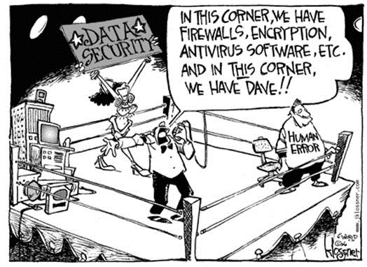
Technology is vital but can only do so much…

Slide 5
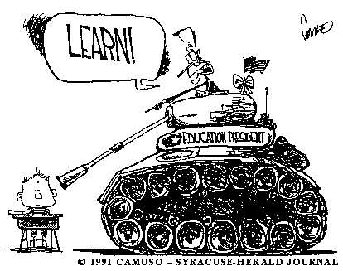
…does this approach work?

Slide 6
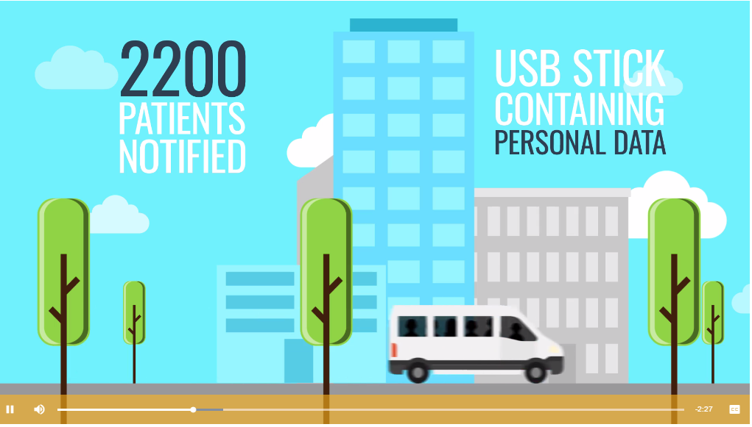
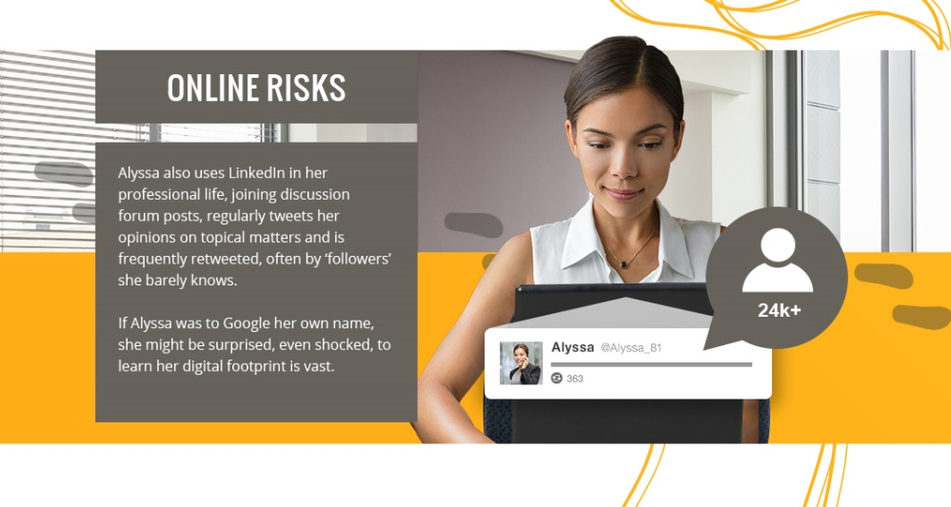
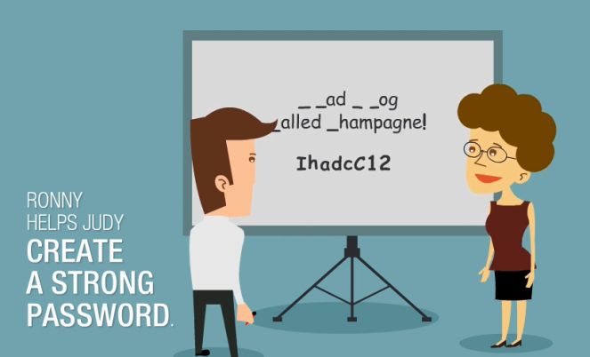

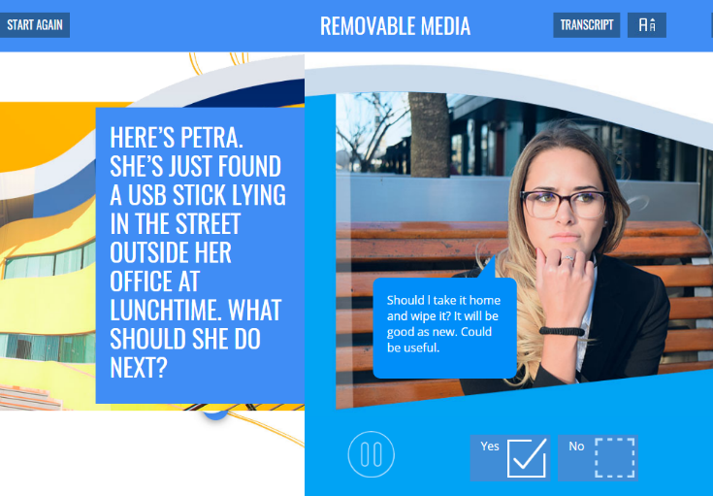
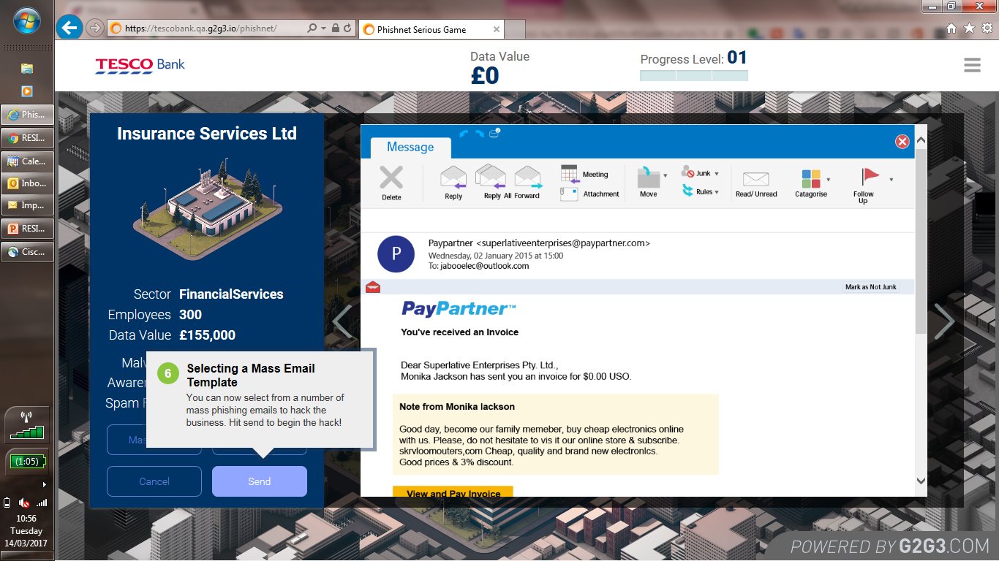


Slide 7

…and what about the boardroom?

Slide 8
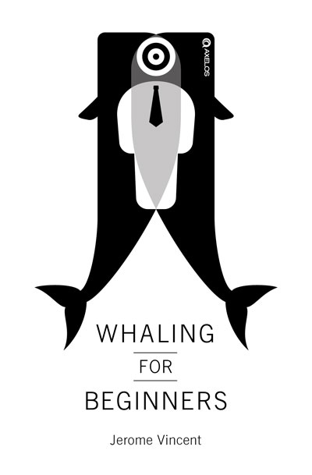
No-one is immune
Whaling for Beginners
Hackers are hunting ‘whales’ in the boardroom. They attack, steal and ruin reputations. Out of nowhere, hard won reputations, competitive advantage, client trust, critical revenues and operational capabilities are all suddenly at risk.
“It takes 20 years to build a reputation and 5 minutes to ruin it. If you think about that, you’ll do things differently”
Warren Buffett

Slide 9

Questions and observations?
Nick Wilding
General Manager, Cyber Resilience
E: nick.wilding@axelos.com
T: 07860 950108

